Slide 1
Chapter 6-11 JavaScript Part1
簡廷因 Ting-Ying Chien
2015.11.02

Slide 2
Outline
Chapter 6 : Introduction to Scripting
Chapter 7 : Control Statements, Part 1
Chapter 8 : Control Statements, Part 2
Chapter 9 : Functions
Chapter 10: Arrays
Chapter 11: Objects

Slide 3
Introduction
JavaScript
Scripting language which is used to enhance the functionality and appearance of web pages.
Before you can run code examples with JavaScript on your computer, you may need to change your browser’s security settings.
IE9 prevents scripts on the local computer from running by default
Firefox, Chrome, Opera, Safari (including on the iPhone) and the Android browser have JavaScript enabled by default.

Slide 4

Your First Script: Displaying a Line of Text with JavaScript in a Web Page
<!DOCTYPE html>
<html>
<head>
<meta charset = "utf-8">
<title>A First Program in JavaScript</title>
<script type = "text/javascript">
document.writeln("<h1>Welcome to JavaScript Programming!</h1>" );
</script>
</head>
<body></body>
</html>

Slide 5
Your First Script: Displaying a Line of Text with JavaScript in a Web Page
All major web browsers contain JavaScript interpreters, which process the commands written in JavaScript.
Often, JavaScripts appear in the <head> section of the HTML5 document
The browser interprets the contents of the <head> section first
The <script> tag indicates to the browser that the text that follows is part of a script. Attribute type specifies the scripting language used in the script—such as text/javascript

Slide 6
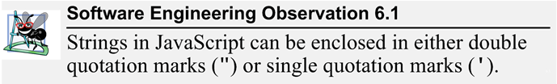
Your First Script: Displaying a Line of Text with JavaScript in a Web Page
A string of characters can be contained between double quotation (") marks (also called a string literal)

Slide 7
Your First Script: Displaying a Line of Text with JavaScript in a Web Page
Browser’s document object represents the HTML5 document currently being displayed in the browser
Allows you to specify HTML5 text to be displayed in the HTML5 document
Browser contains a complete set of objects that allow script programmers to access and manipulate every element of an HTML5 document

Slide 8
Your First Script: Displaying a Line of Text with JavaScript in a Web Page
Object
Resides in the computer’s memory and contains information used by the script
The term object normally implies that attributes (data) and behaviors (methods) are associated with the object
An object’s methods use the attributes’ data to perform useful actions for the client of the object—the script that calls the methods
Attributes - things that the object stores data in, generally variables.
Methods - Functions and Procedures attached to an Object and allowing the object to perform actions

Slide 9
Your First Script: Displaying a Line of Text with JavaScript in a Web Page
The parentheses () following the name of a method contain the arguments that the method requires to perform its task (or its action)
Every statement should end with a semicolon ; (also known as the statement terminator)
JavaScript is case sensitive
Not using the proper uppercase and lowercase letters is a syntax error

Slide 10
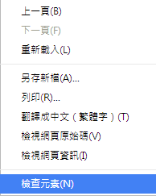
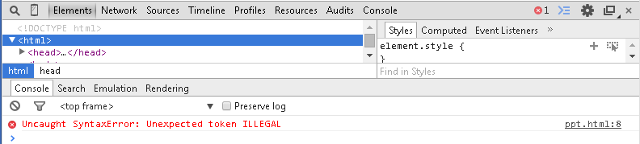
Your First Script: Displaying a Line of Text with JavaScript in a Web Page
The document object’s writeln method
Writes a line of HTML5 text in the HTML5 document
How to debug?

Slide 11
Modifying Your First Script
<!DOCTYPE html>
<html>
<head>
<meta charset = "utf-8">
<title>Printing a Line with Multiple Statements</title>
<script>
document.write( "<h1 style = 'color: magenta'>" );
document.write( "Welcome to JavaScript " +
"Programming!</h1>" );
</script>
</head><body></body>
</html>

Slide 12
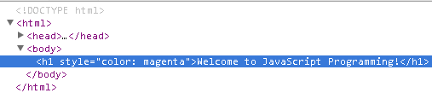
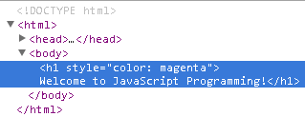
Modifying Your First Script
Method write displays a string like writeln, but does not position the output cursor in the HTML5 document at the beginning of the next line after writing its argument
The + operator (called the "concatenation operator" when used in this manner) joins two strings together
write
writeln

Slide 13
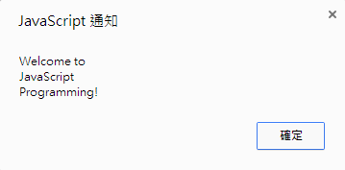

Modifying Your First Script
<!DOCTYPE html>
<html>
<head>
<meta charset = "utf-8">
<title>Printing Multiple Lines in a Dialog Box</title>
<script>
window.alert( "Welcome to\nJavaScript\nProgramming!" );
</script>
</head>
<body>
<p>Reload the page to run this script again.</p>
</body>
</html>

Slide 14
Modifying Your First Script
Displaying Text in an Alert Dialog
Dialogs
Useful to display information in windows that "pop up" on the screen to grab the user’s attention
Typically used to display important messages to the user browsing the web page
Browser’s window object uses method alert to display an alert dialog
Method alert requires as its argument the string to be displayed

Slide 15
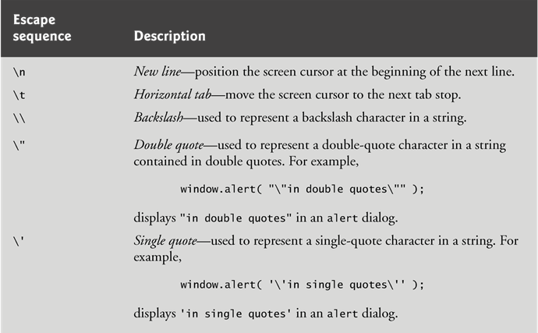
Modifying Your First Script
Escape Sequences
When a backslash is encountered in a string of characters, the next character is combined with the backslash to form an escape sequence. The escape sequence \n is the newline character. It causes the cursor in the HTML5 document to move to the beginning of the next line.

Slide 16
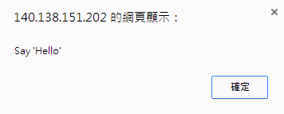
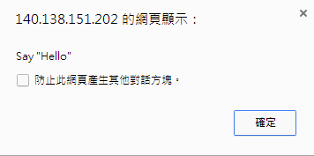
Exercise
Escape Sequences
Single double v.s double quotation

Slide 17
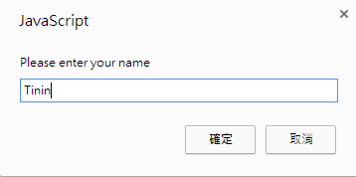
Dynamic Welcome Page
<!DOCTYPE html>
<html>
<head>
<meta charset = "utf-8">
<title>Using Prompt and Alert Boxes</title>
<script>
var name; // string entered by the user
// read the name from the prompt box as a string
name = window.prompt( "Please enter your name" );
document.writeln( "<h1>Hello " + name +
", welcome to JavaScript programming!</h1>" );
</script>
</head><body></body>
</html>

Slide 18
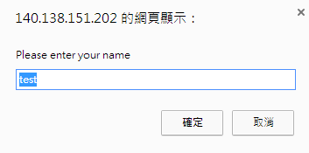
Dynamic Welcome Page
The script uses another predefined dialog box from the window object—a prompt dialog—which allows the user to enter a value that the script can use.
The first argument is a message (called a prompt) that directs the user to take a specific action.
The optional second argument is the default string to display in the text field.
Script can then use the value that the user inputs.
name = window.prompt( "Please enter your name", "test" );

Slide 19
Dynamic Welcome Page
Keywords are words with special meaning in JavaScript
Keyword var
Used to declare the names of variables
A variable is a location in the computer’s memory where a value can be stored for use by a script
All variables have a name, type and value, and should be declared with a var statement before they are used in a script
A variable name can be any valid identifier consisting of letters, digits, underscores ( _ ) and dollar signs ($) that does not begin with a digit and is not a reserved JavaScript keyword.

Slide 20
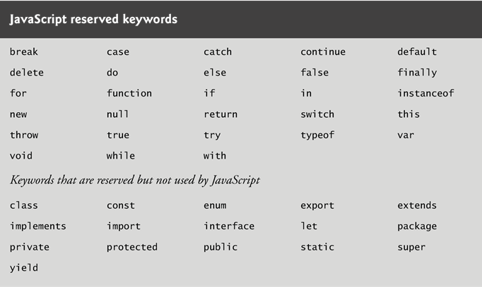
Dynamic Welcome Page

Slide 21
Dynamic Welcome Page
Declarations end with a semicolon (;) and can be split over several lines, with each variable in the declaration separated by a comma (forming a comma-separated list of variable names)
Several variables may be declared in one declaration or in multiple declarations.
Comments
A single-line comment begins with the characters // and terminates at the end of the line
Comments do not cause the browser to perform any action when the script is interpreted; rather, comments are ignored by the JavaScript interpreter
Multiline comments begin with delimiter /* and end with delimiter */
All text between the delimiters of the comment is ignored by the interpreter.

Slide 22
Dynamic Welcome Page
A variable is assigned a value with an assignment statement, using the assignment operator, =.
The = operator is called a binary operator, because it has two operands.

Slide 23
Variables
JavaScript does not require variables to have a type before they can be used in a script
A variable in JavaScript can contain a value of any data type, and in many situations, JavaScript automatically converts between values of different types for you
JavaScript is referred to as a loosely typed language
When a variable is declared in JavaScript, but is not given a value, it has an undefined value.
Attempting to use the value of such a variable is normally a logic error.
When variables are declared, they are not assigned default values, unless specified otherwise by the programmer.
To indicate that a variable does not contain a value, you can assign the value null to it.

Slide 24
Variables
null keyword
Signifies that a variable has no value
null is not a string literal, but rather a predefined term indicating the absence of value
Writing a null value to the document, however, displays the word “null”

Slide 25
Adding Integers
<!DOCTYPE html>
<html>
<head>
<meta charset = "utf-8">
<title>An Addition Program</title>
<script>
var firstNumber; // first string entered by user
var secondNumber; // second string entered by user
var number1; // first number to add
var number2; // second number to add
var sum; // sum of number1 and number2
// read in first number from user as a string
firstNumber = window.prompt( "Enter first integer" );
// read in second number from user as a string
secondNumber = window.prompt( "Enter second integer" );
// convert numbers from strings to integers
number1 = parseInt( firstNumber );
number2 = parseInt( secondNumber );
sum = number1 + number2; // add the numbers
// display the results
document.writeln( "<h1>The sum is " + sum + "</h1>" );
</script>
</head><body></body>
</html>

Slide 26
Adding Integers
Function parseInt
converts its string argument to an integer
JavaScript has a version of the + operator for string concatenation that enables a string and a value of another data type (including another string) to be concatenated
Number() | Converts an object's value to a number
parseFloat() | Parses a string and returns a floating point number
parseInt() | Parses a string and returns an integer
String() | Converts an object's value to a string

Slide 27
Arithmetic
The basic arithmetic operators (+, -, *, /, and %) are binary operators, because they each operate on two operands
JavaScript provides the remainder operator, %, which yields the remainder after division
Arithmetic expressions in JavaScript must be written in straight-line form to facilitate entering programs into the computer

Slide 28
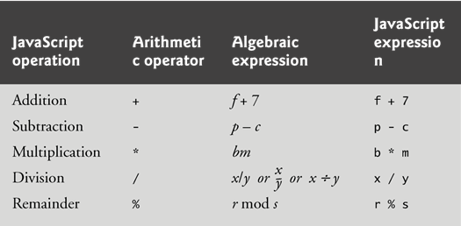
Arithmetic

Slide 29
Control Statements
JavaScript provides three selection structures.
The if statement either performs (selects) an action if a condition is true or skips the action if the condition is false.
Called a single-selection statement because it selects or ignores a single action or group of actions.
The if…else statement performs an action if a condition is true and performs a different action if the condition is false.
Double-selection statement because it selects between two different actions or group of actions.
The switch statement performs one of many different actions, depending on the value of an expression.
Multiple-selection statement because it selects among many different actions or groups of actions.

Slide 30
if Selection Statement
if statement allows a script to make a decision based on the truth or falsity of a condition
If the condition is met (i.e., the condition is true), the statement in the body of the if statement is executed
If the condition is not met (i.e., the condition is false), the statement in the body of the if statement is not executed
Conditions in if statements can be formed by using the equality operators and relational operators

Slide 31
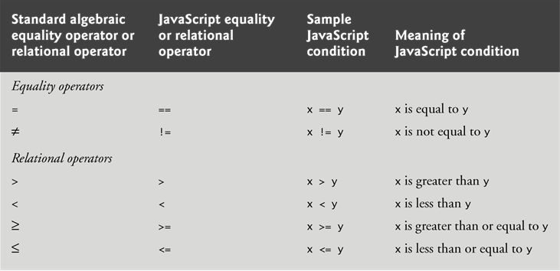
if Selection Statement
Equality and Relational Operators

Slide 32
if Selection Statement
Logical Operators
Logical operators can be used to form complex conditions by combining simple conditions
&& (logical AND)
|| (logical OR)
! (logical NOT, also called logical negation)
JavaScript evaluates to false or true all expressions that include relational operators, equality operators and/or logical operators
Description | Operator
and | &&
or | ||
not | !

Slide 33
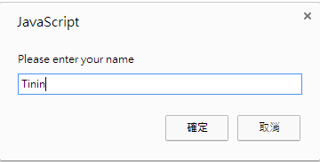
if Selection Statement
<!DOCTYPE html>
<html>
<head>
<meta charset = "utf-8">
<title>Using Relational Operators</title>
<script>
var name; // string entered by the user
var now = new Date(); // current date and time
var hour = now.getHours(); // current hour (0-23)
name = window.prompt( "Please enter your name" );
if ( hour < 12 ) // determine whether it's morning
document.write( "<h1>Good Morning, " );
if ( hour >= 12 ) // determine whether the time is PM
{
hour = hour - 12; // convert to a 12-hour clock
if ( hour < 6 ) // determine whether it is before 6 PM
document.write( "<h1>Good Afternoon, " );
if ( hour >= 6 ) // determine whether it is after 6 PM
document.write( "<h1>Good Evening, " );
} // end if
document.writeln( name +
", welcome to JavaScript programming!</h1>" );
</script>
</head><body></body>
</html>

Slide 34
if Selection Statement
Date object
Used acquire the current local time
Create a new instance of an object by using the new operator followed by the type of the object, Date, and a pair of parentheses

Slide 35
if Selection Statement
Date Get Methods
getDate() | Get the day as a number (1-31)
getDay() | Get the weekday a number (0-6)
getFullYear() | Get the four digit year (yyyy)
getHours() | Get the hour (0-23)
getMilliseconds() | Get the milliseconds (0-999)
getMinutes() | Get the minutes (0-59)
getMonth() | Get the month (0-11)
getSeconds() | Get the seconds (0-59)
getTime() | Get the time (milliseconds since January 1, 1970)

Slide 36
if Selection Statement
The JavaScript interpreter ignores white-space characters
blanks, tabs and newlines used for indentation and vertical spacing
A decision can be made on any expression that evaluates to a value of JavaScript’s boolean type (i.e., any expression that evaluates to true or false).
The indentation convention you choose should be carefully applied throughout your scripts
It is difficult to read scripts that do not use uniform spacing conventions

Slide 37
if...else Selection Statement
Allows you to specify that different actions should be performed when the condition is true and when the condition is false.

Slide 38
if...else Selection Statement
Conditional operator (?:)
Closely related to the if…else statement
JavaScript’s only ternary operator—it takes three operands
The operands together with the ?: operator form a conditional expression
The first operand is a boolean expression
The second is the value for the conditional expression if the boolean expression evaluates to true
Third is the value for the conditional expression if the boolean expression evaluates to false

Slide 39
Nested if…else statements
The JavaScript interpreter always associates an else with the previous if, unless told to do otherwise by the placement of braces ({})
The if selection statement expects only one statement in its body
To include several statements, enclose the statements in braces ({ and })
A set of statements contained within a pair of braces is called a block

Slide 40
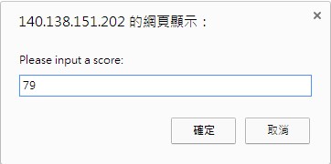

Exercise
Input : Midterm Score
Output : Grading
80 + : A
70 ~ 79 : B
60 ~ 69 : C
59 - : D

Slide 41
switch Multiple-Selection Statement
switch statement
Consists of a series of case labels and an optional default case
When control reaches a switch statement
The script evaluates the controlling expression in the parentheses
Compares this value with the value in each of the case labels
If the comparison evaluates to true, the statements after the case label are executed in order until a break statement is reached

Slide 42
switch Multiple-Selection Statement
The break statement is used as the last statement in each case to exit the switch statement immediately
The default case allows you to specify a set of statements to execute if no other case is satisfied
Usually the last case in the switch statement

Slide 43
Switch Selection Statement
<!DOCTYPE html>
<html>
<head>
<meta charset = "utf-8">
<title>Using Relational Operators</title>
<script>
var str;
var now = new Date();
var day = now.getDay();
switch (day) {
case 0:
str = "Sunday";
break;
case 1:
str = "Monday";
break;
case 2:
str = "Tuesday";
break;
case 3:
str = "Wednesday";
break;
case 4:
str = "Thursday";
break;
case 5:
str = "Friday";
break;
case 6:
str = "Saturday";
break;
}
document.writeln( "<h1>Today is " + str + ", welcome to JavaScript programming!</h1>" );
</script>
</head><body></body>
</html>

Slide 44
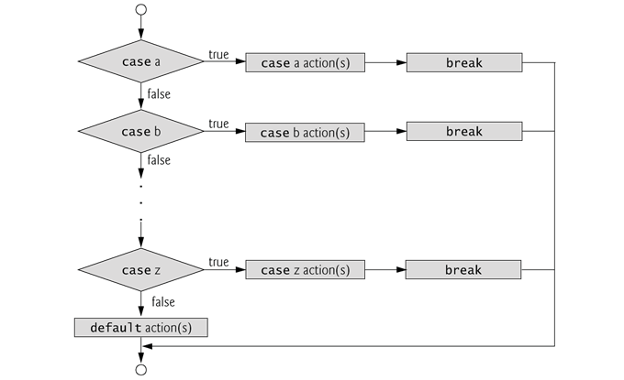
switch Multiple-Selection Statement

